Slide 1
Computer Organization & Assembly Language
Lecture 02
by Omar Bin Samin

Slide 2
Today’s Discussion
Assembly Link Execute Cycle

Slide 3
Assembling and Running Programs
A source program written in assembly language cannot be executed directly on its target computer
It must be translated, or assembled into an executable code

Slide 4
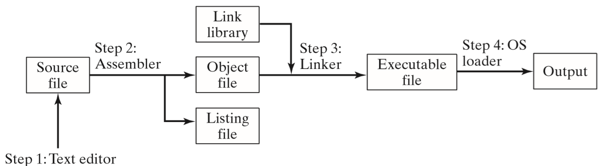
Assembly Link Execute Cycle

Slide 5
Step 1:
A programmer uses a text editor to create a source file
The extension of a source file is .asm
Step 2:
The assembler reads the source file and produces an object file (a machine-language translation of the program)
Optionally, it produces a listing file (it contains a copy of the program’s source code, line numbers, offset addresses and translated machine code)
The extension of a listing file is .lst
If any error occurs, the programmer must return to Step 1 and fix the error

Slide 6
Step 3:
The linker reads the object file and checks to see if the program contains any calls to libraries or functions
The linker copies required libraries or functions from the link library, combines them with the object file and produces an executable file
The extension of an executable file is .com
Step 4:
The operating system loader utility reads the executable file into memory and branches the CPU to the program’s starting address and the program begins to execute

Slide 7
Video lecture can be accessed at
https://www.youtube.com/watch?v=FLVVojwdQXc

